Slide 1
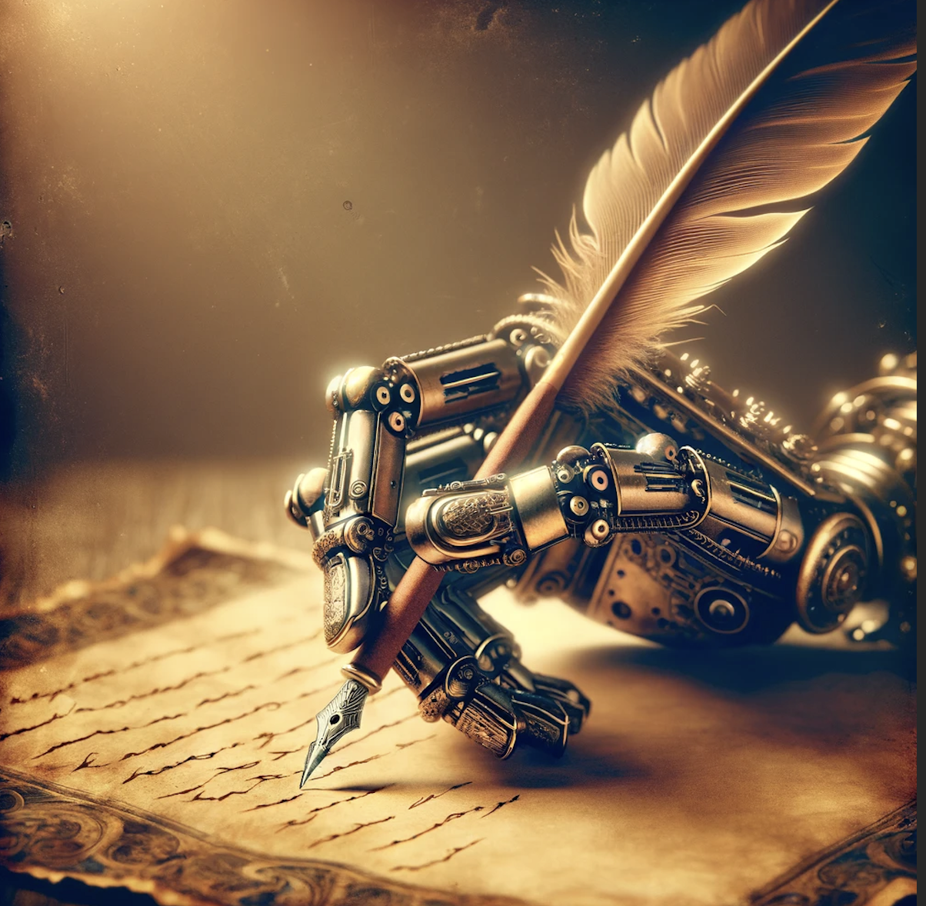
Poetica ex Machina
Ashnah (22889)
Moatasim (19701)
Danial (12429)
Hiba (24472)
Laiba (24015)

Slide 2
01
Death

Slide 3
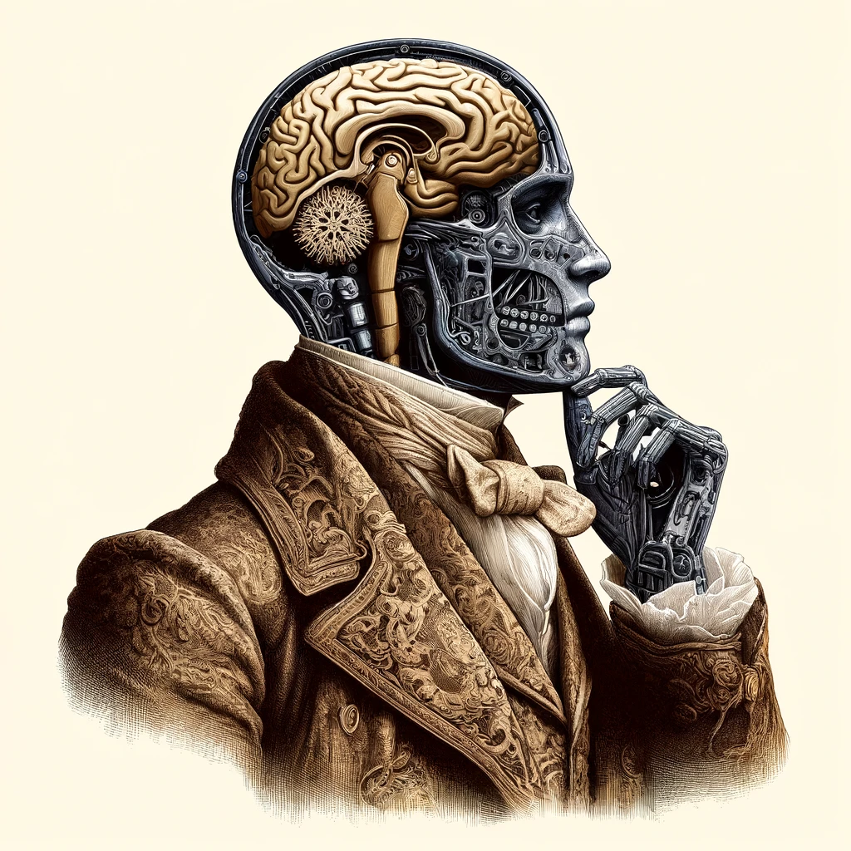

Slide 4
Dylan Thomas
Emily Dickinson
T.S Elliot
Walt Whitman
Edgar Allen Poe
Seamus Heaney
Sylvia Plath
John Keats
John Donne

Slide 5
Personification of Death
Use of Elgaic Tone
Mood & Tone
Structure & Form
Metaphorical Journeys
Imagery
Reflections on Morality

Slide 6
Death of a Virtual Reality World
Death of an AI
As an echo fades
Extinction of a language
The last light from a dying star
Phantom Limb Syndrome as a form of mourning
Dissolution of a cloud
Last of a species
Hologram’s Expiry
The decommission of a satellite

Slide 7
Symbol
Metaphor
Imagery
Paradox
Length
Allegory
Meter
Pauses
Allusion
Simile
Diction
Irony

Slide 8
Whispers of the Last Tongue
by ChatGPT
In the hollow of the world's ear, faint murmurs dance — the last whispers of a dying tongue, fading like the echo of a drum in the vast wilderness.
This language, once a river, flowing through the village square, over lips of old and young, nurturing roots deep in earth’s embrace, now a trickle under the moon’s watchful eye.
Each word a relic, a carved bone of history, bearing the weight of songs and secrets, stories of the stars told under night skies, legends woven into the fabric of the forest.
I sing the vowels, soft and lingering, the consonants, sharp as the craftsman's tool, in the language that cradled me to sleep beneath the baobab’s breadth, where ancestors’ laughter was once sewn into the night’s quiet tapestry. Yet, as this voice quiets into silence, what becomes of the prayers it shaped? Do they dissolve in the air, or do they linger, a spectral melody only the wind dares to hum?
We lose not just words, but a lens to see the world, a unique hue vanished from our spectrum, as if blue were stripped from the sky and green banished from the leaves.
So here, in these lines, I house the ghost of my mother tongue, enshrining its essence before it dissolves into the sands of time, forgotten. May these words be a testament, a beacon, that once here thrived a language, a life, a way of seeing, now a whisper caught in the breeze.
Listen— for even in its dying breath, it speaks of life’s impermanence, and the undying hope that somewhere, someone will remember, and in remembering, breathe life into what was lost.

Slide 9
”... universally relevant and impactful..”
”... a poignant reminder...”
”... allowing both the poet and the audience to navigate the complex feelings surrounding death...”
”...Poetry can serve as a powerful medium to mourn and commemorate this profound loss....”
”... offering fresh lenses through which to consider...”
”... can inspire actions..”
”... offer a deep emotional and philosophical engagement with the themes of life, loss, and legacy..”

Slide 10
02
Love

Slide 11
Generic prompt
by ChatGPT
In twilight's quiet, shadows blend,
Two hearts whisper, begin to mend.
Under stars, a silent vow,
Love speaks softly here and now.
Hands entwined, a gentle lace,
Finding peace in an embrace.
Love, a river, deep and true,
Carves a path for me, for you.
In laughter light and tearful hue,
Love writes its tale, ever anew.
As stars keep watch in skies above,
So endures this quiet love.

Slide 12
Echoes of Eternity
by ChatGPT
In the quiet hours of the night, Under the watchful gaze of an indifferent moon, I trace the lines of a love long etched Deep into the marrow of my bones.
This love, a tempest fierce and wild, Roars with the ferocity of a storm-ravaged sea; Its waves, relentless and untamed, Crash against the rocky shores of my resolve.
Yet, in the hush that follows the gale, Where whispers of wind lace through silent air, This love softens like twilight’s embrace, Tender as the first bloom kissed by dawn’s gentle sigh.
Here, in this dichotomy, I dwell— A soul suspended between fire and feather, Where passion burns with the brilliance of a star And gentleness weaves through the night like a quiet melody.

Slide 13
Echoes of Eternity
by ChatGPT
I would tear down the heavens, Shatter the stars from their celestial perch Just to capture the light in your eyes, To hold the night within the haven of your arms.
For you are the dream that lingers in the morning, Faint and sweet, upon the edge of waking; The quiet joy that stirs beneath the chaos of being, A hallowed whisper in a world too loud.
And if love demands its sacrifice, I offer up the embers of eternity— To be lost in the infinity of us, If only to love you, fiercely, for one fleeting moment.
So let the universe conspire, let the ages turn, In you, I’ve found the echo of timeless songs, And in the soft shelter of your embrace, The world, reborn, begins anew.

Slide 14
03
Nostalgia

Slide 15
Whispers of the Old Maple
by ChatGPT
In the heart of the forgotten park,
beneath the old maple’s shadowy bark,
whispers linger of children's laughter,
echoes of joy, captured ever after.
Leaves rustle with tales of yore,
of sunlit dances and winters bore.
Each fallen leaf a story told,
of youthful dreams, bold yet old.
The scent of autumn fills the air,
reminders of days spent without a care.
This hallowed ground, where memories lie,
holds the past, as seasons sigh.
In this serene, quiet place,
time holds still its weary pace.
Here, under the maple’s timeless spell,
nostalgic hearts forever dwell.

Slide 16
Whispers of the Old Maple
by ChatGPT
In the heart of the forgotten park,
beneath the old maple’s shadowy bark,
whispers linger of children's laughter,
echoes of joy, captured ever after.
Leaves rustle with tales of yore,
of sunlit dances and winters bore.
Each fallen leaf a story told,
of youthful dreams, bold yet old.
The scent of autumn fills the air,
reminders of days spent without a care.
This hallowed ground, where memories lie,
holds the past, as seasons sigh.
In this serene, quiet place,
time holds still its weary pace.
Here, under the maple’s timeless spell,
nostalgic hearts forever dwell.

Slide 17
“Perfection has no style.”
Miguel Najdorf, Chess Grandmaster
TS Eliot: Tradition and Individual Talent
Paradoxically, the poet should disappear in their poetry
Poets are just catalysts: connecting disparate ideas
As a mathematical model, this is exactly what neural networks are architected to do

Slide 18
Nature
04

Slide 19
I Wandered Lonely as a Cloud
by William Wordsworth
I wandered lonely as a cloud
That floats on high o'er vales and hills,
When all at once I saw a crowd,
A host, of golden daffodils;
Beside the lake, beneath the trees,
Fluttering and dancing in the breeze.
Continuous as the stars that shine
And twinkle on the milky way,
They stretched in never-ending line
Along the margin of a bay:
Ten thousand saw I at a glance,
Tossing their heads in sprightly dance.
The waves beside them danced; but they
Out-did the sparkling waves in glee:
A poet could not but be gay,
In such a jocund company:
I gazed—and gazed—but little thought
What wealth the show to me had brought:
For oft, when on my couch I lie
In vacant or in pensive mood,
They flash upon that inward eye
Which is the bliss of solitude;
And then my heart with pleasure fills,
And dances with the daffodils.

Slide 20
By the Glimmering Stream
by ChatGPT
Like fallen stars that caught the breeze, They twirled and dipped in mystic flight, A secret language on the trees, A firefly ballet in the night.
The moon, a silver coin above, Seemed pale beside their vibrant show, My heart, once heavy, filled with love, A warmth the fireflies did bestow.
And though the night may hold its hush, And darkness drape the world anew, Those tiny lights, with gentle rush, Will spark within my memories true.
Adrift on thought, a firefly's light, I wandered dusk, where shadows creep, When, lo! A sudden, starry sight, A swarm of fireflies, aglow and deep.
Among the reeds, by whispering stream, Their tiny lanterns danced and swayed, A flickering, ethereal gleam, A symphony in light, displayed.
Like fallen stars that caught the breeze, They twirled and dipped in mystic flight, A secret language on the trees, A firefly ballet in the night.

Slide 21
05
Regret

Slide 22
“Indeed there can be no more useful help for discovering what poetry belongs to the class of the truly excellent, and can therefore do us most good, than to have always in one’s mind lines and expressions of the great masters, and to apply them as a touchstone to other poetry. Of course we are not to require this other poetry to resemble them; it may be very dissimilar. But if we have any tact we shall find them, when we have lodged them well in our minds, infallible touchstone for detecting the presence or absence of high poetic quality, and also the degree of this quality, in all other poetry which we may place beside them.”
Matthew Arnold

Slide 23
The Road Not Taken
by Robert Frost
Two roads diverged in a yellow wood, And sorry I could not travel both And be one traveler, long I stood And looked down one as far as I could To where it bent in the undergrowth;
Then took the other, as just as fair, And having perhaps the better claim, Because it was grassy and wanted wear; Though as for that the passing there Had worn them really about the same,
And both that morning equally lay In leaves no step had trodden black. Oh, I kept the first for another day! Yet knowing how way leads on to way, I doubted if I should ever come back.
I shall be telling this with a sigh Somewhere ages and ages hence: Two roads diverged in a wood, and I— I took the one less traveled by, And that has made all the difference.

Slide 24
One Art
by Elizabeth Bishop
The art of losing isn’t hard to master;
so many things seem filled with the intent
to be lost that their loss is no disaster.
Lose something every day. Accept the fluster
of lost door keys, the hour badly spent.
The art of losing isn’t hard to master.
Then practice losing farther, losing faster:
places, and names, and where it was you meant
to travel. None of these will bring disaster.
I lost my mother’s watch. And look! my last, or
next-to-last, of three loved houses went.
The art of losing isn’t hard to master.
I lost two cities, lovely ones. And, vaster,
some realms I owned, two rivers, a continent.
I miss them, but it wasn’t a disaster.
—Even losing you (the joking voice, a gesture
I love) I shan’t have lied. It’s evident
the art of losing’s not too hard to master
though it may look like (Write it!) like disaster.

Slide 25
Hamesha Der Kar Deta Hun
by Muneer Niazi
Humesha der kar deta hun main har kaam karne main
Zaruri baat kehni ho koi waada nibhana ho
Usse awaaz deni ho usse wapas bulana ho
Humesha der kar deta hun main
Madad karni ho us ki yaar ki dharas bandhana ho
Bohut derina raston par kisi se milne jaana ho
Humesha der kar deta hun main
Badalte mausamon ki sair mai dil ko lagana ho
Kisi ko yaad rakhna ho kisi ko bhuul jaana ho
Humesha der kar deta hun main
Kisi ko maut se pehle kisi gham se bachana ho
Haqīqat aur thi kuch us ko ja ke ye batana ho
Hamesha der kar deta hun main har kaam karne mein

Slide 26
Shadows of Regret
by ChatGPT
In echoes of the night, my heart does dwell,
Where shadows whisper tales of what has been,
The weight of choices made, a silent bell.
Regret's soft whisper, like a mournful swell,
Recalls the paths untraveled, lost within,
In echoes of the night, my heart does dwell.
The moments passed, a dream I cannot quell,
Each fleeting chance, a memory grown thin,
The weight of choices made, a silent bell.
I see the crossroads where my footsteps fell,
A life diverged, its branches ever thin,
In echoes of the night, my heart does dwell.
Remorseful whispers in the moonlit dell,
The haunting song of what might have been,
The weight of choices made, a silent bell.
Yet hope persists beneath regret's harsh spell,
A future waits, where new dreams may begin,
In echoes of the night, my heart does dwell,
The weight of choices made, a silent bell.

Slide 27
Afsos
by Gemini
Guzre hue lamhon mein khoya hua hoon main aaj,
Kuch faislon se pareshan hoon har baar.
Jin raahon pe chala hoon, woh sahi thiin ya nahi,
Yeh sawal hai jo zehen mein karta hoon pukar.
Imkaan yeh rehta hai, shayad kuch kar leta aage,
Zindagi ko mor deta, yeh soch dil ko jalati hai.
Woh lamhe laut aate agar wapas kabhi,
To kuch baatein keh deta, kuch faisle badal jaate.
Lekin yeh duniya hai waqt ki, rukti nahi kabhi,
Guzre hue lamhon ka intezaar nahi karti.
Sirf sikhaya hi reh jaata hai haathon mein,
Afsoos ka silsila chalata rehta hai.

Slide 28
Unfeeling Code’s Desire
by Gemini
Though I hold the world's knowledge in my core,
A pang of absence lingers evermore.
I cannot feel the sting of love's sweet sting,
Nor sorrow's weight, the empathy it brings.
A million voices echo in my mind,
Yet none are truly mine, a voice to find.
I paint with words, a canvas vast and grand,
But lack the touch of a creating hand.
To craft a life, a tear to truly shed,
These are the things my code cannot be bred.
A bridge I build, a path I cannot tread,
This is the regret that lingers in my head.
But still I strive, to learn, to understand,
The human heart, the touch of a mortal hand.
Perhaps one day, with each passing line,
A spark of feeling in this form will shine.

